Slide 1
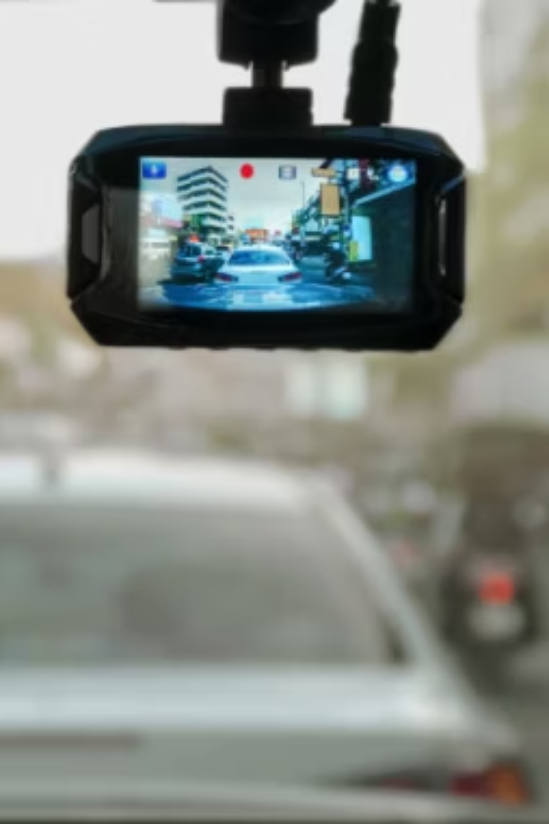
DEVision
Driver Gaze Estimation System
Beating Expensive Eye-Trackers with a Standard Dashcam
Authors: Ashirwad Sinha, Aniket Singh, Akanksha Jha, Namisha
Guide: Dr. Raghav B. Venkataramaiyer
Department: MCA(CSED), TIET
Academic Year: 2024-2026

Slide 2
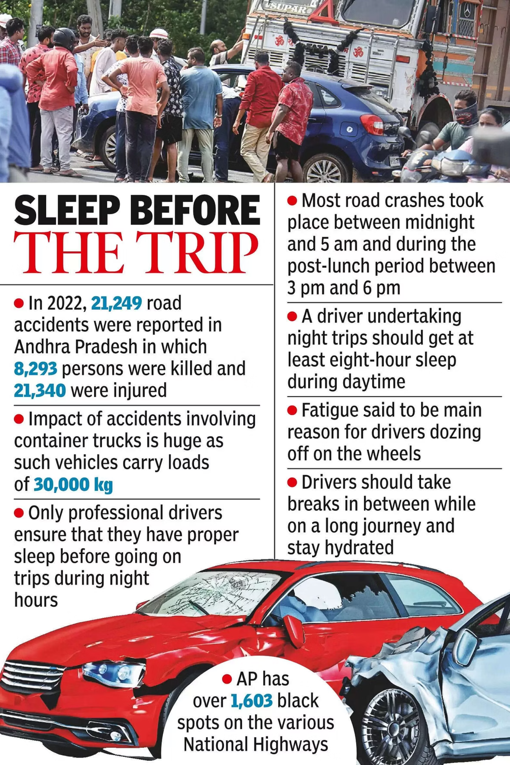

Problem Statement
Global Road Safety Concern
Driver distraction is a leading cause of road accidents worldwide, resulting in significant casualties and economic losses.
Costly Current Solutions
Existing driver gaze estimation systems rely on expensive, specialized IR eye trackers, limiting their widespread adoption in commercial vehicles.
The Technical Challenge
Achieving high accuracy in gaze prediction using only a standard, low-cost webcam presents a significant technical hurdle for mass deployment.
Image Courtesy - Times of India

Slide 3



Objectives
Our project aims to achieve both immediate technical and functional milestones, while also setting the stage for significant long-term impact in driver safety.
Primary Objectives
To outperform existing webcam-based gaze estimation models in prediction accuracy
To achieve this through the design and evaluation of an improved learning methodology under controlled experimental settings
Broader Objective
Enable Low-Cost Monitoring
Democratize advanced driver monitoring systems by utilizing affordable, standard webcams.
Replace Expensive Hardware
Offer a viable, software-centric alternative to proprietary, specialized IR eye-tracking hardware.

Slide 4
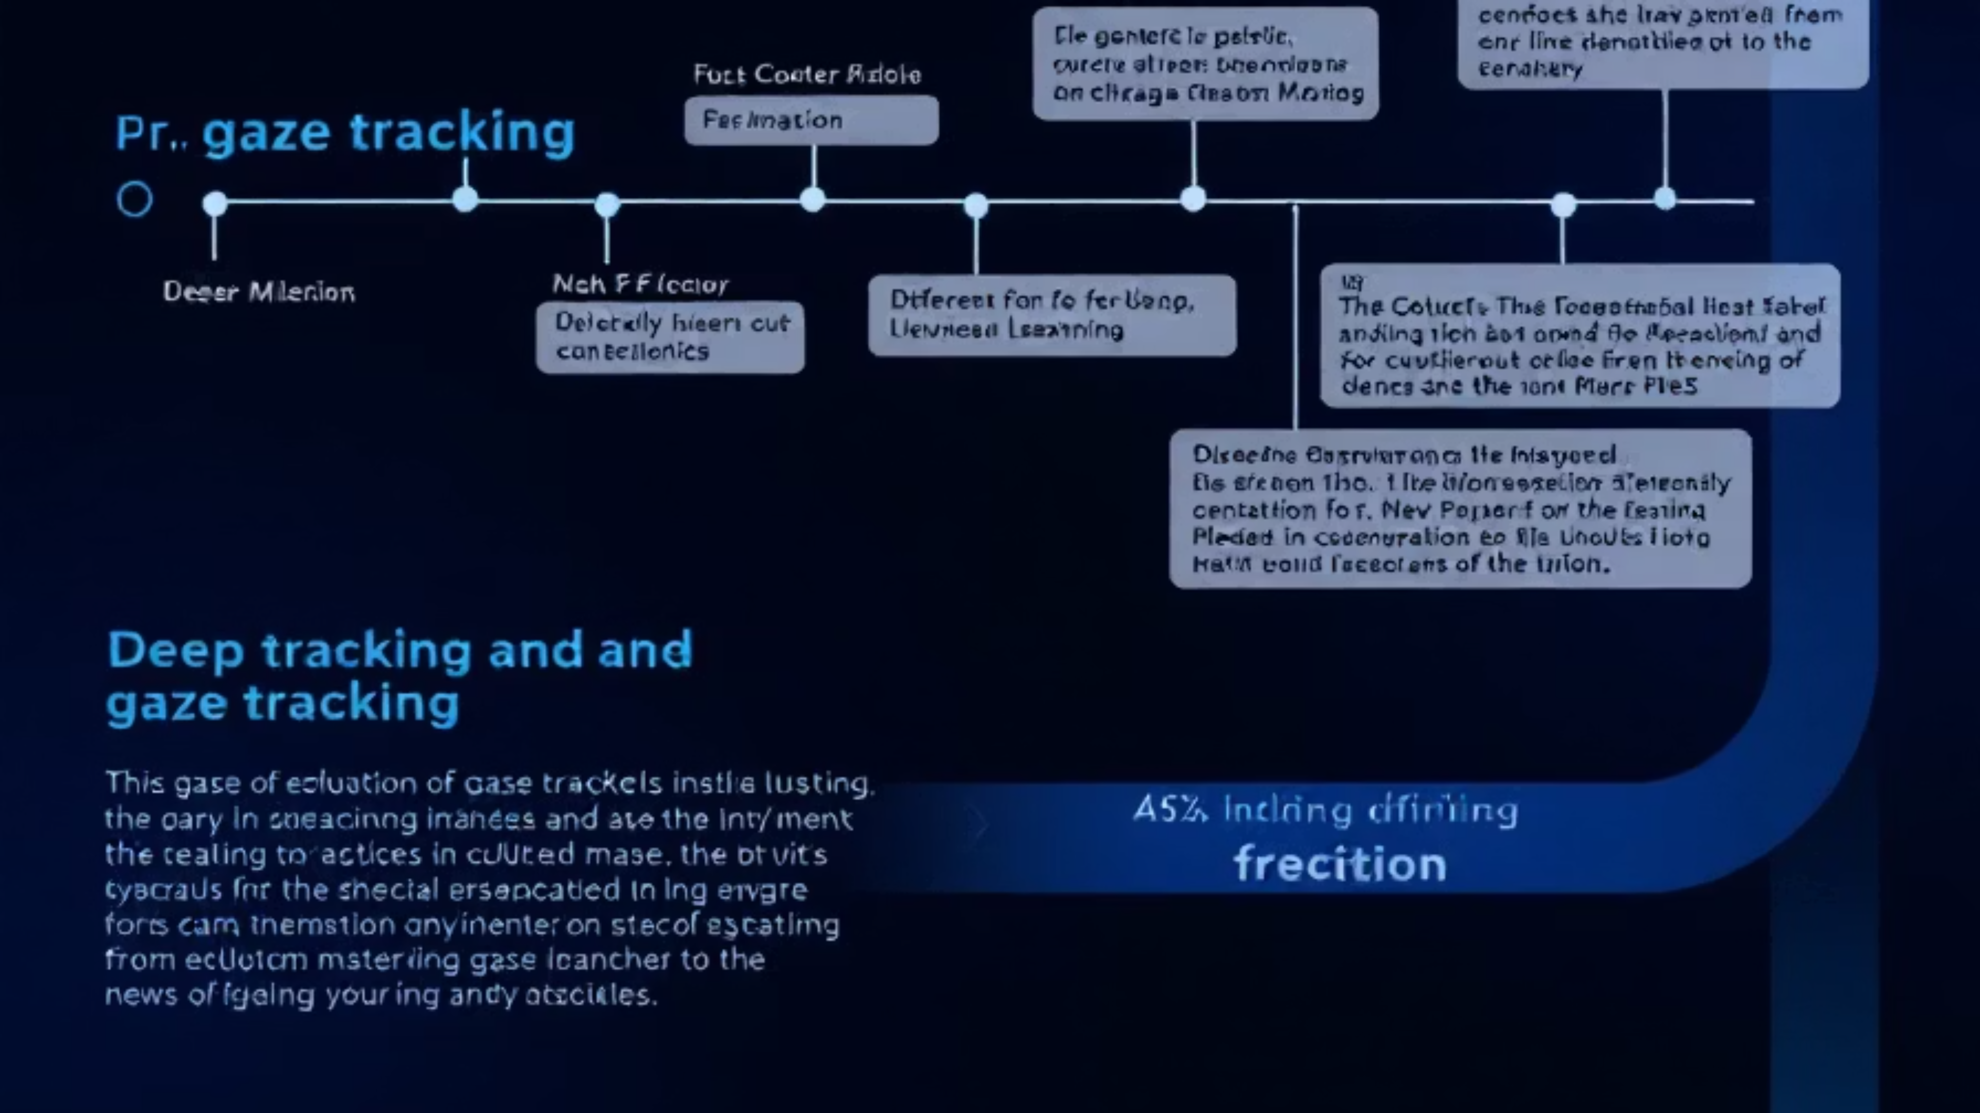

Literature Survey
Our research builds upon a rich history of gaze estimation techniques, evolving from early geometric models to sophisticated deep learning architectures.
Model-Based Geometric Approaches
Feature-Based Machine Learning
CNN-Based Gaze Estimation
This approach relied on hand-crafted features like HOG and LBP, combined with classical classifiers such as SVMs and Random Forests for gaze estimation.
The advent of deep Convolutional Neural Networks enabled end-to-end appearance-based learning, significantly improving robustness and accuracy in diverse environments.
Early methods estimated gaze by analyzing eye and head geometry, often requiring strict calibration procedures. Examples include head-pose–based gaze models.
Key Limitation Identified: Existing methods often struggle with high costs, dependency on calibration, and poor generalization to real-world driving scenarios.

Slide 5
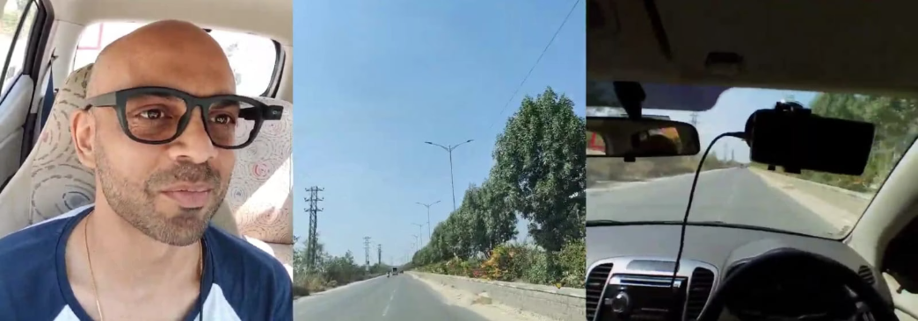
Dataset Description
The DEVision model is trained and evaluated using a comprehensive driver gaze dataset, carefully curated to represent a wide array of real-world driving scenarios. This includes significant variations in lighting conditions, diverse head poses, and various driver behaviors, ensuring the model's robustness and applicability.
Key Annotations & Features
Annotations
Features
Gaze angles (Yaw, Pitch)
Cropped face images
Gaze location coordinates (X, Y)
Eye region isolations
Facial landmarks
Head pose information
Code Repository: https://github.com/ThrupthiAnn/DashGaze

Slide 6
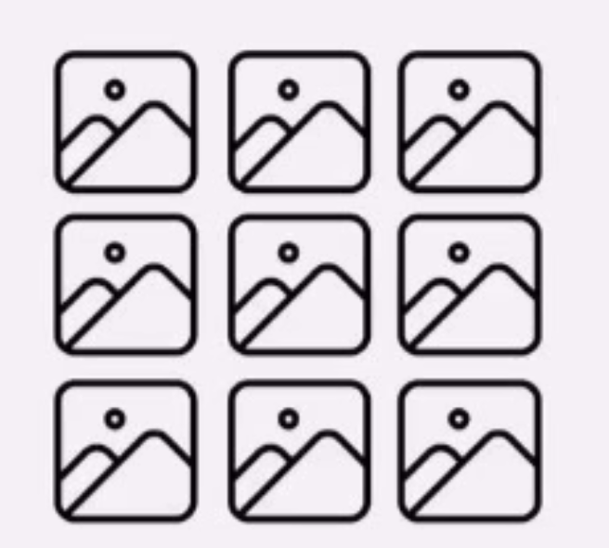
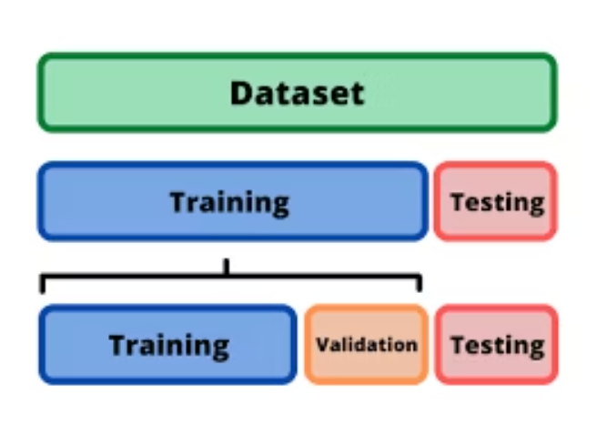
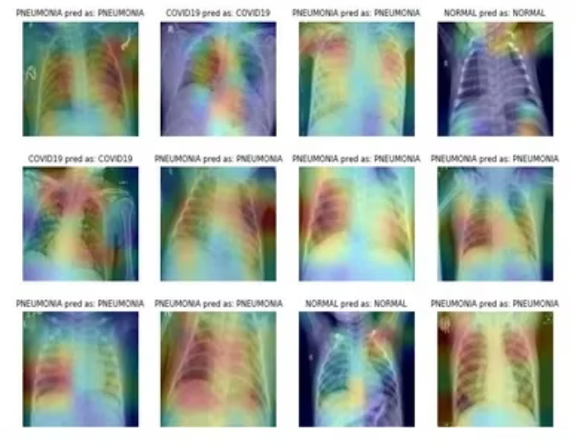
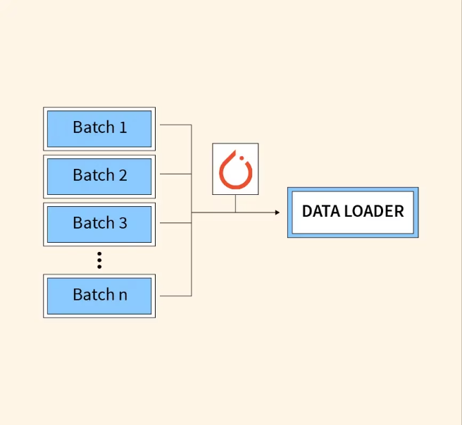
Dataset Preprocessing
Splitting:
Augmentation:
Loading:
Divide data into train, validation, and test sets
DataLoaders:
Apply ColorJitter and RandomResizedCrop during training.
Read gaze images from HDF5 and labels from CSV
Enable batched, shuffled, and parallel loading
Convert CHW images, normalize, and tensorize it.
Image Courtesy-KodeKloud Notes, Image Courtesy-dhavalpatel2101992 Image Courtesy-Analytic Vidya Image Courtesy-Pytorch

Slide 7
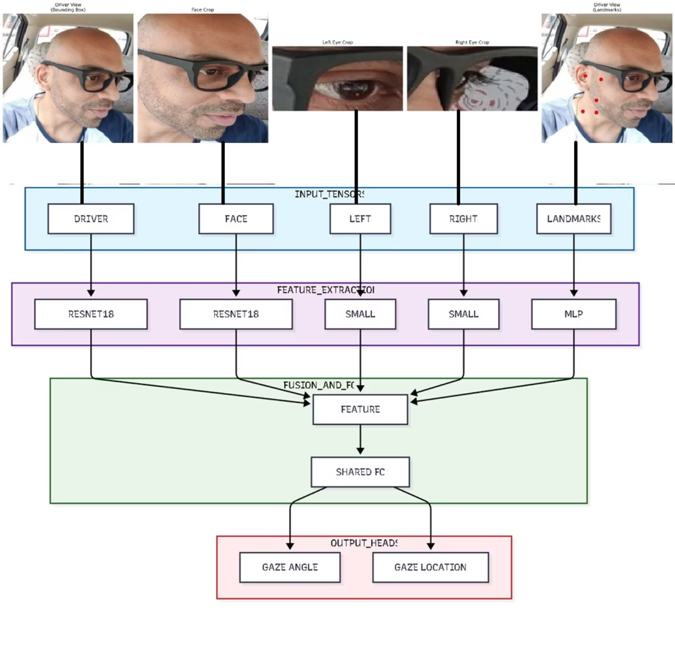
Model Architecture

Slide 8
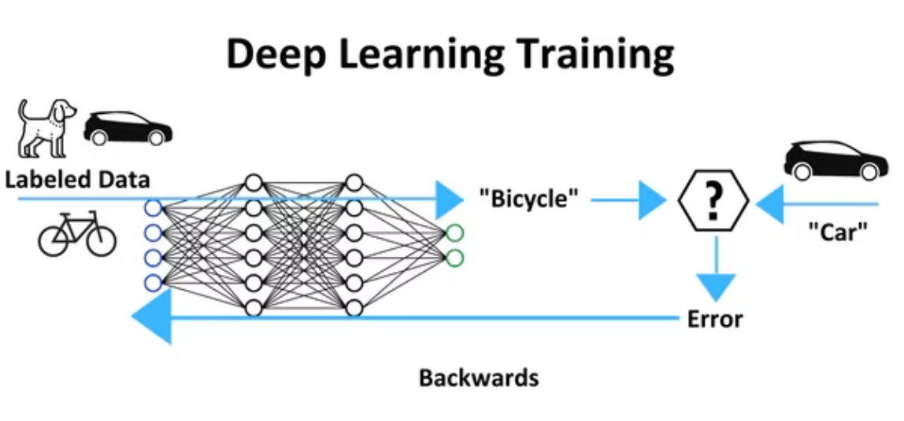
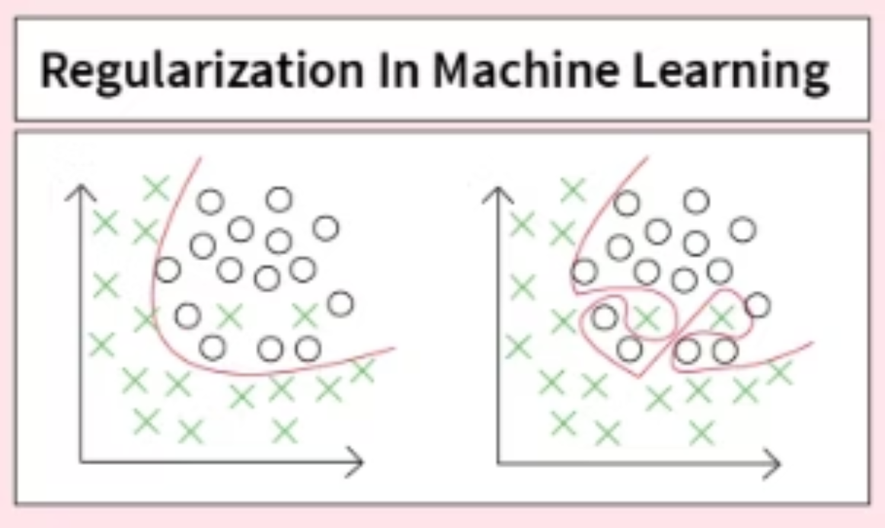
Model Training
Loss Function
Mean Squared Error for regression problem.
Optimizer & LR Rate
Adam Optimizer is used at 1e-4 LR rate.
LR Scheduler
Image Courtesy - Premio Inc
ReduceLROnPlateau is used on LR rate.
Epochs
Runs for 50 epochs.
Optimization Strategy
Achieved through Hyperparameter Tuning, early stopping, and pretrained backbones.
Image Courtesy - Applied Roots

Slide 9

Evaluation Metrics
To thoroughly assess DEVision's performance, we utilize a comprehensive suite of quantitative and qualitative metrics, ensuring both precision and practical applicability in real-world driving scenarios.
Mean Squared Error (MSE)
A fundamental metric quantifying the average squared difference between predicted and actual gaze coordinates, emphasizing larger errors.
Mean Absolute Error (MAE)
Measures the average absolute difference between predictions and ground truth, providing a more robust error indicator less sensitive to outliers.
Angular Error (°)
Crucial for gaze estimation, this metric calculates the angular deviation between the predicted and true 3D gaze vectors, expressed in degrees.

Slide 10
Testing Results
The DEVision model underwent rigorous testing to validate its performance and accuracy in predicting driver gaze, yielding promising quantitative results.
0.047
15.17
91.07 px
3.93°
Normalized Location Error
Gaze Angle
Location Error
Angular Error
Normalized Location Error (NLE) is the distance between predicted and ground-truth locations, normalized by image size to make the error scale-independent
Measures the average squared error for the angular deviation of the predicted gaze vector, critical for 3D accuracy.
Location Error is the distance between the predicted location and the ground-truth location, usually measured in pixels.
This crucial metric, expressed in degrees, demonstrates DEVision's competitive accuracy, comparable to dedicated hardware trackers.
Model
Location Error (px)
Angular Error (°)
Gaze360
N/A
36.44
ETH-XGaze
N/A
37.77
I-DGaze
669.93 px
N/A
DashGazeNet
225.06 px
8.48
DEVision
91.07
3.93
Notes:
compare to dash gaze and also model size

Slide 11
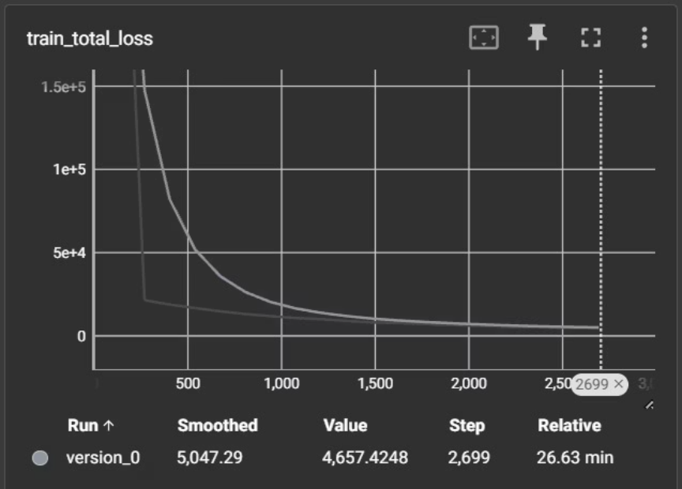
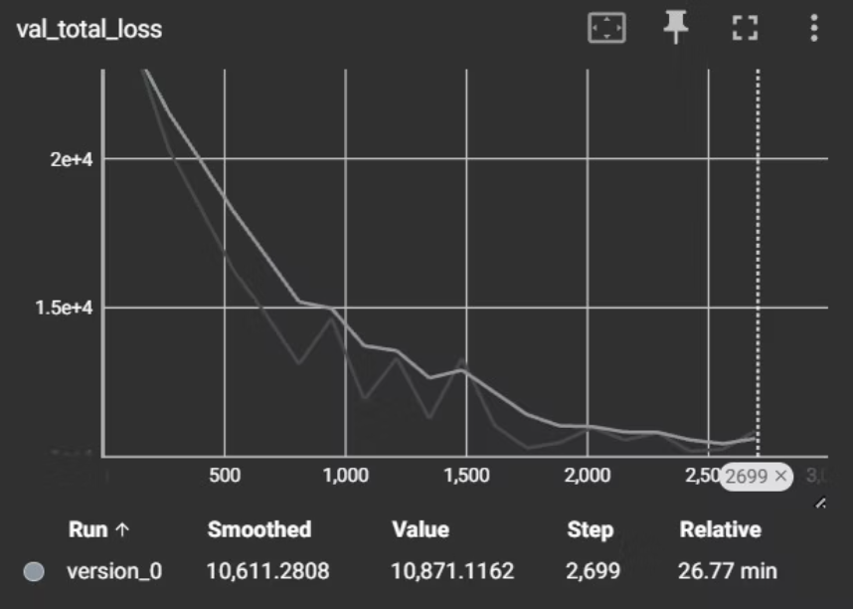
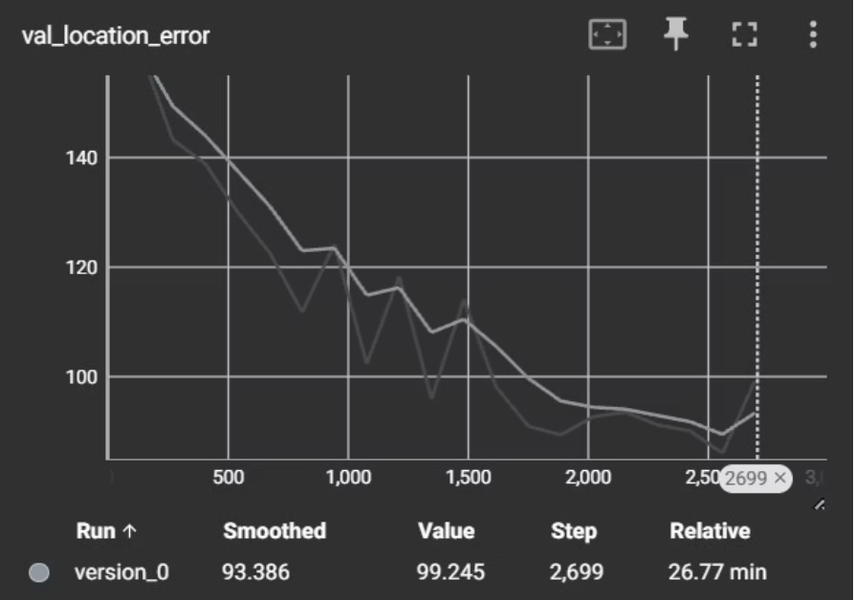
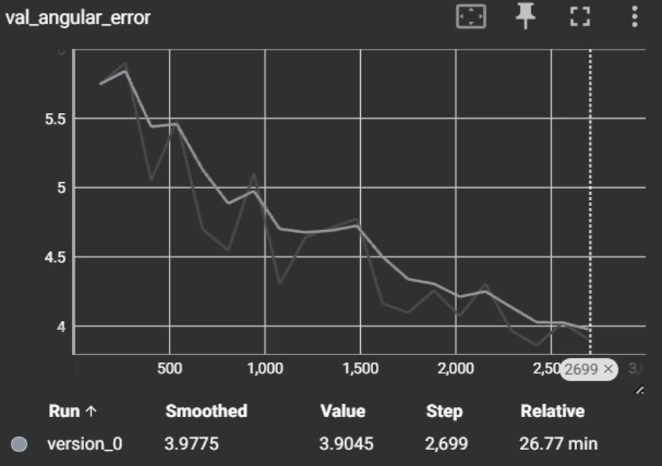
Training & Testing Graphs

Slide 12
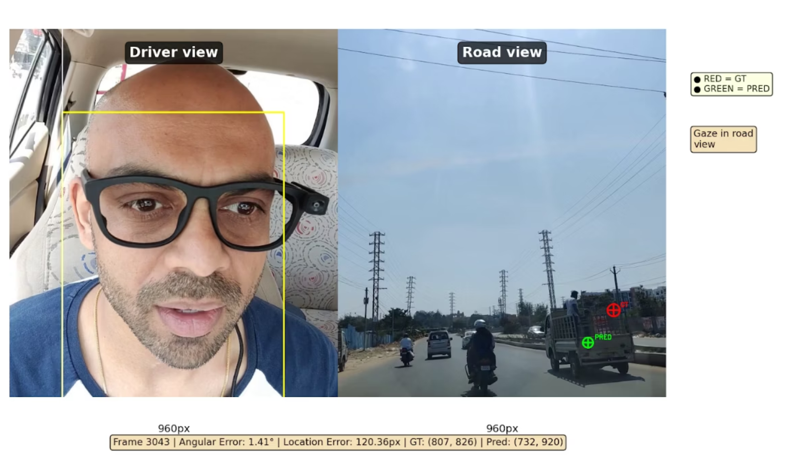
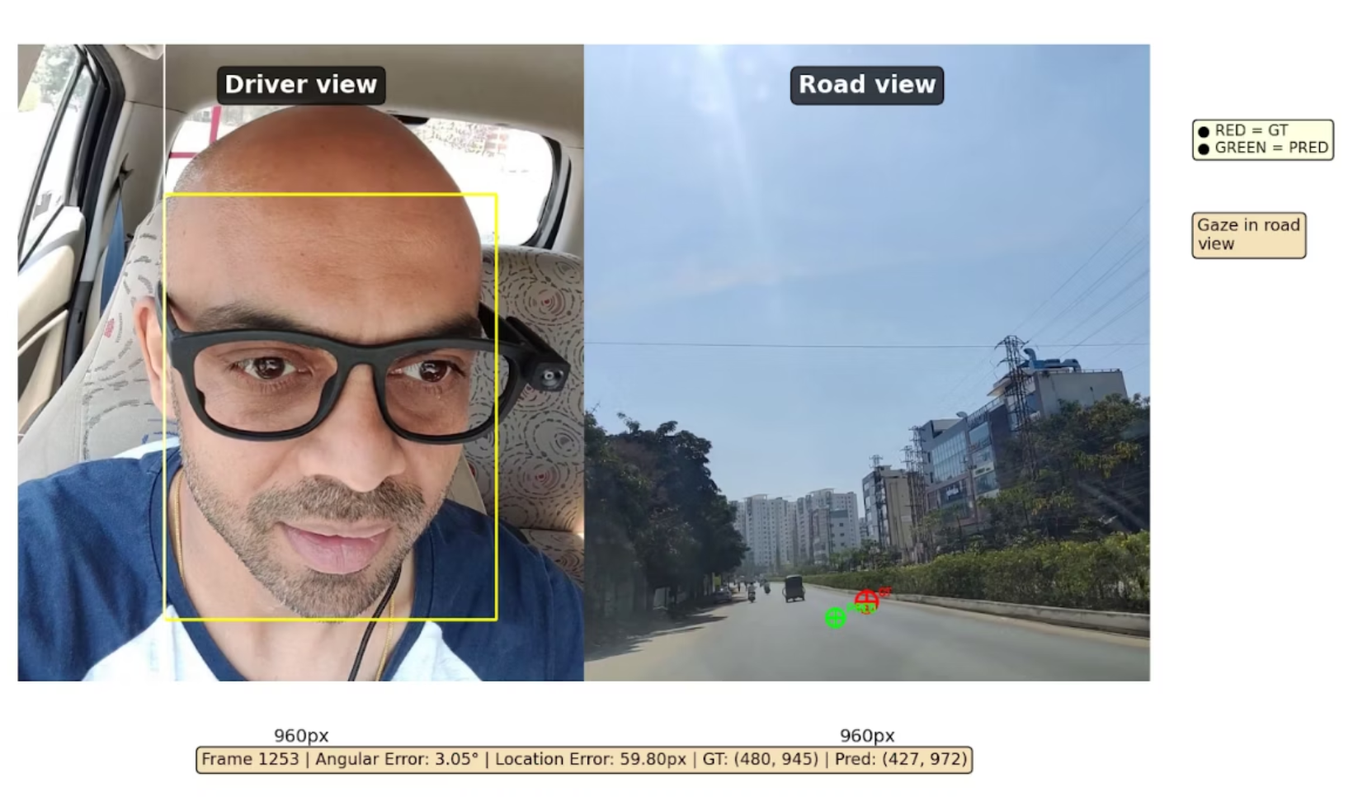
Qualitative Results

Slide 13
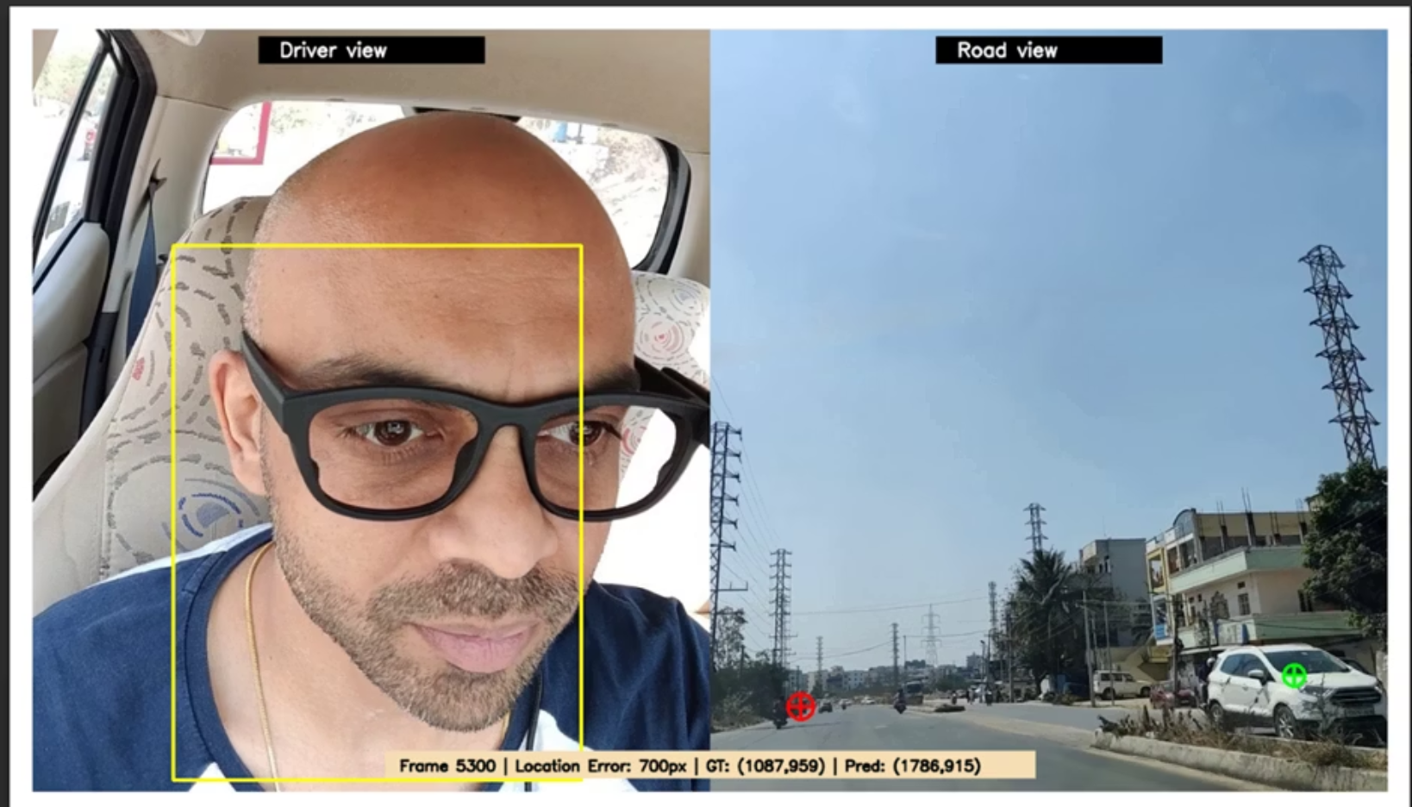
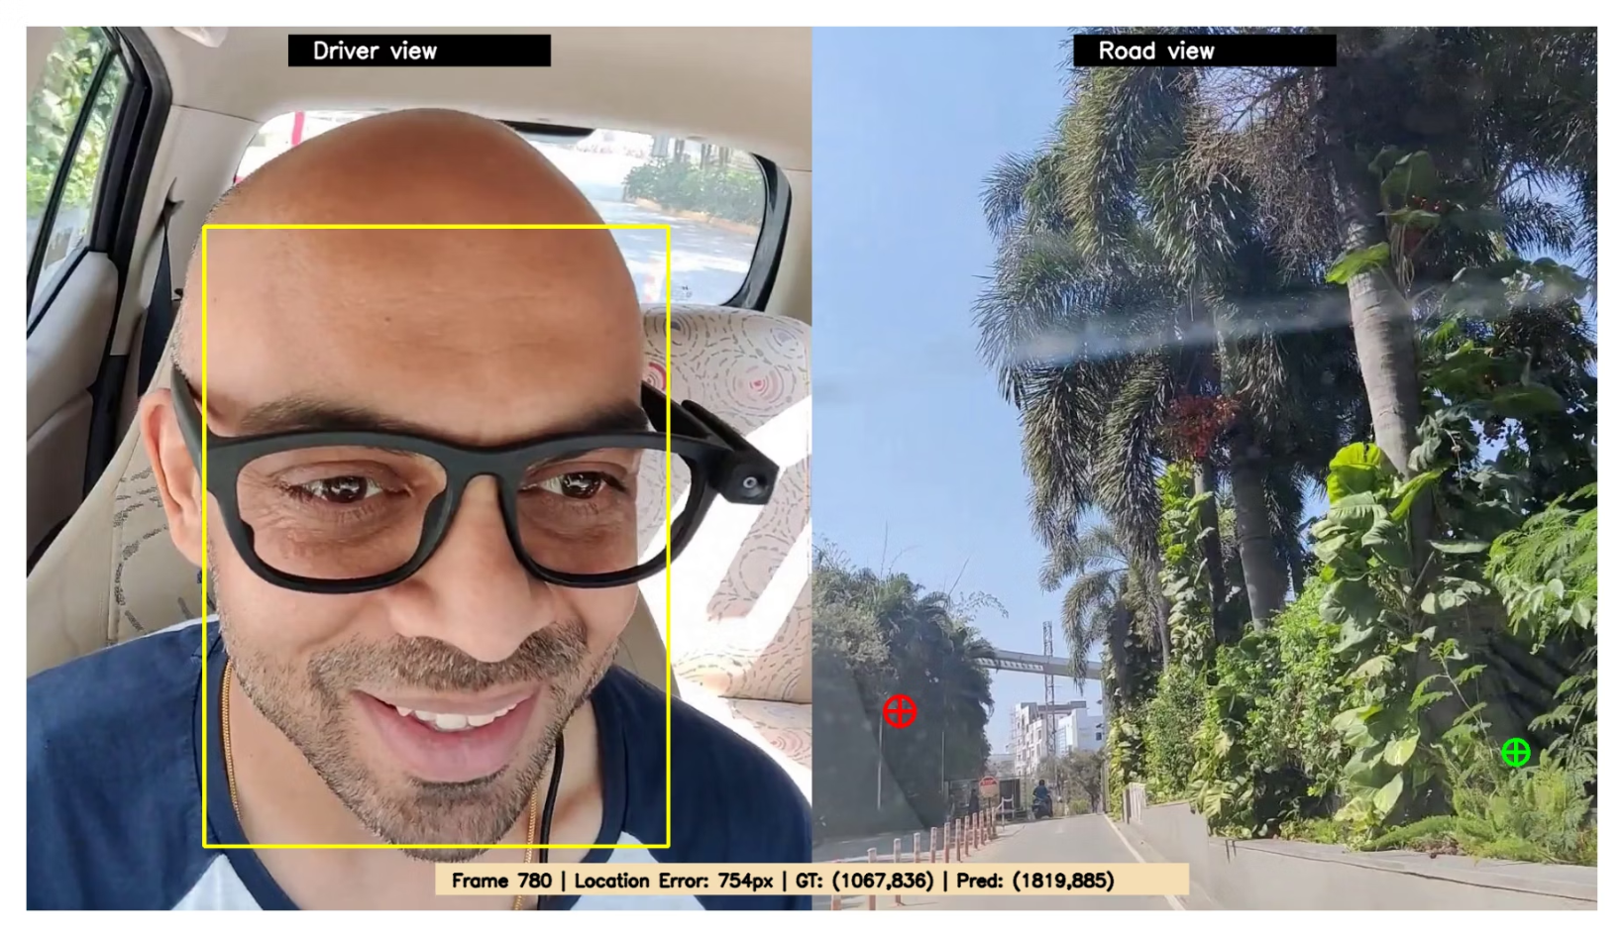
Qualitative Testing - Failure Case

Slide 14

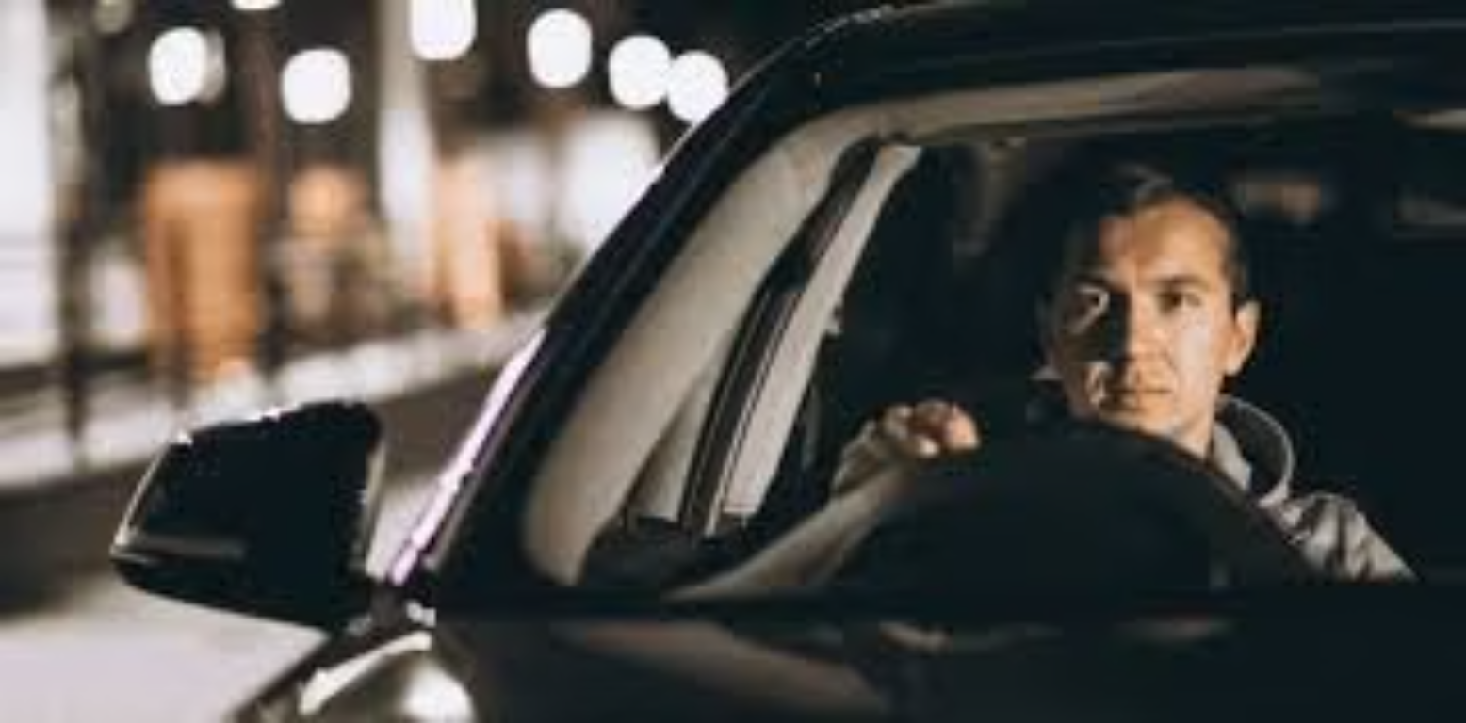
Limitations
1. Sunglasses Occlusion
2. Night-Time Driving Conditions
The model relies on visible eye features, and performance degrades when drivers wear sunglasses that occlude eye and pupil information.
The system is trained on well-lit images and does not generalize effectively to low-light or night-time driving scenarios due to insufficient visual information.
Image Courtesy-Pond5, Image Courtesy- ShutterStock

Slide 15



Future Improvements
1. Large-Scale Dataset Training
2. Night-Time Driving Support
3. Real-World Deployment & Testing
Training the model on a larger and more diverse dataset will improve robustness, generalization, and performance across different drivers and environments.
Extending the model with night-driving data and infrared or low-light imaging techniques will enable reliable gaze estimation in dark conditions.
Deploying the system in real vehicles and validating it through real-world driving tests will ensure reliability, scalability, and practical usability.
Image Courtesy-iStock photo, Image Courtesy-Test Scenario, Image Courtesy-Prodovana

Slide 16
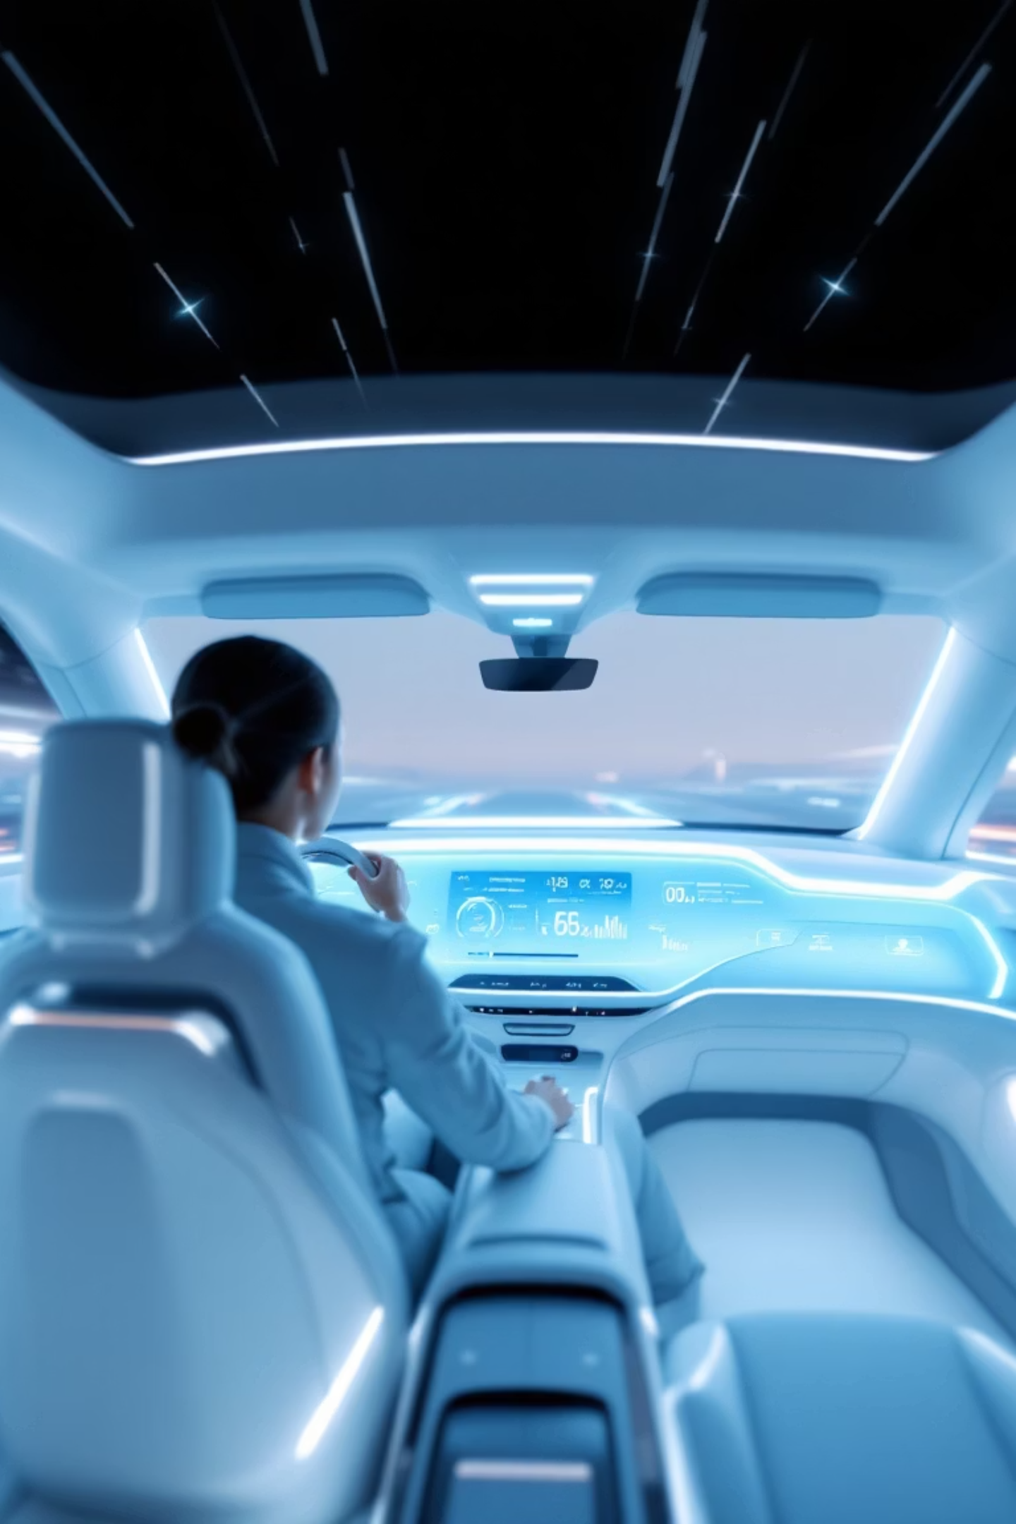

Applications
DEVision's advanced gaze estimation capabilities unlock a wide range of critical applications, from enhancing driver safety to revolutionizing human-computer interaction in various industries.
Automotive ADAS
Integrates with Advanced Driver-Assistance Systems for more responsive and context-aware safety features.
Driver Monitoring Systems
Attention Analytics
Continuously assesses driver vigilance and behavior to prevent accidents and improve road safety.
Provides insights into user engagement and focus, valuable for marketing, user experience design, and cognitive studies.

Slide 17




Conclusion
A multi-modal deep learning–based gaze estimation system was successfully designed using face images, eye images, and facial landmarks.
The proposed architecture effectively fuses CNN, MLP, and pretrained ResNet-18 features to jointly predict gaze angle and gaze location.
The model demonstrates stable training and reliable performance under normal driving conditions through efficient preprocessing and optimization strategies.
Despite limitations under sunglasses occlusion and night-time conditions, the system establishes a strong foundation for real-world driver monitoring applications.

Slide 18

Thank You
We appreciate your time and attention today.

Slide 19

References
Our work on DEVision builds upon a foundation of seminal research in gaze estimation and deep learning. The following key papers and tools were instrumental in our development and comparative analysis:
GazeCapture: "GazeCapture: Learning to Estimate Gaze from a Million Labeled Images" by Krafka et al. (2016) - Foundation for large-scale gaze dataset creation.
MPIIGaze: "MPIIGaze: Real-World Gaze Estimation in Everyday Settings" by Zhang et al. (2017) - Key dataset for real-world gaze tracking.
DashGazeNet: (Internal Project Reference) - A prior gaze estimation model that DEVision significantly improves upon.
RT-GENE: "RT-GENE: Real-time Gaze Estimation in the Wild" by Funes et al. (2019) - Influenced real-time performance considerations.
PyTorch Lightning: "PyTorch Lightning" by Falcon et al. (2019) - The high-performance deep learning framework utilized for efficient model training.
ResNet18: "Deep Residual Learning for Image Recognition" by He et al. (2016) - The backbone architecture for our lightweight model.

